Slide 1


Activity recognition in Smart Home
By Nataliya Nadtoka, Data Scientist
https://www.linkedin.com/in/nataliya
co-organizer SF Data Mining
May 18th 2015

Slide 2

IOT of connected home

Slide 3
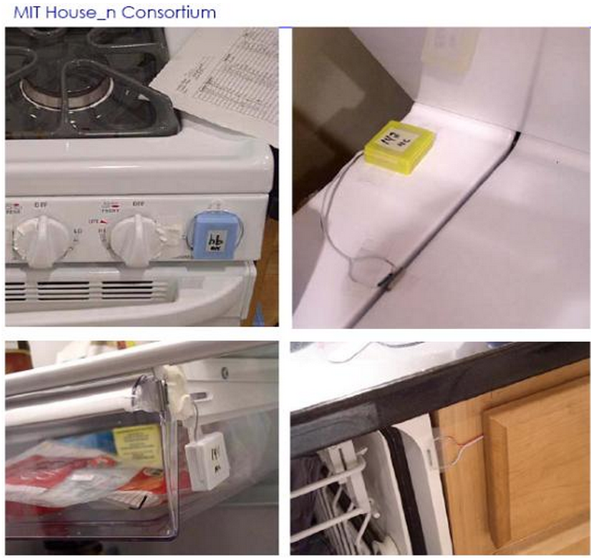
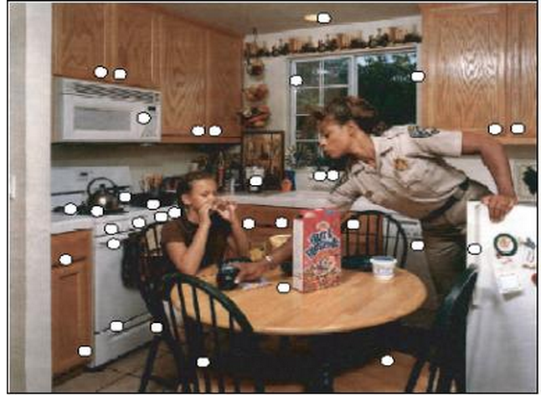
Dataset
http://courses.media.mit.edu/2004fall/mas622j/04.projects/home/
22 Every day Activities
2 weeks of sensor data in March/April 2003
Sensors in the smart home placed in:
Bathroom
Foyer
Kitchen
Living room
Bedroom
Porch
Office/study

Slide 4
Some activities had less than five examples…
Activity | Number of Examples
Other | 1
Washing hands | 1
Going out for entertainment | 1
Lawnwork | 1
Going out for shopping | 2
Putting away dishes | 2
Putting away laundry | 2
Putting away groceries | 2
Watching TV | 3

Slide 5
The activities we used:
Activity | Number of Examples
Preparing dinner | 8
Washing dishes | 8
Cleaning | 9
Going out to work | 12
Preparing breakfast | 14
Preparing a snack | 15
Preparing a beverage | 15
Preparing lunch | 17
Bathing | 18
Doing laundry | 19
Dressing | 24
Grooming | 37
Toileting | 84

Slide 6
Main Challenge: Data format
Toileting,4/1/2003,11:52:1,11:58:50
100,137
Toilet Flush,Freezer
11:55:43,11:56:2
16:35:49,11:56:13
Going out to work,4/1/2003,12:11:26,12:15:12
81,139,140
Closet,Jewelry box,Door
12:12:29,12:13:27,12:13:45
12:13:0,12:13:35,12:13:48
Preparing lunch,4/1/2003,11:21:17,11:38:22
140,137,131,53,84,131
Door,Freezer,Toaster,Cabinet,Drawer,Toaster
11:23:4,11:23:55,11:24:8,11:34:59,11:35:4,11:35:12
11:23:7,11:24:3,11:24:14,11:35:1,11:35:7,11:35:22

Slide 7
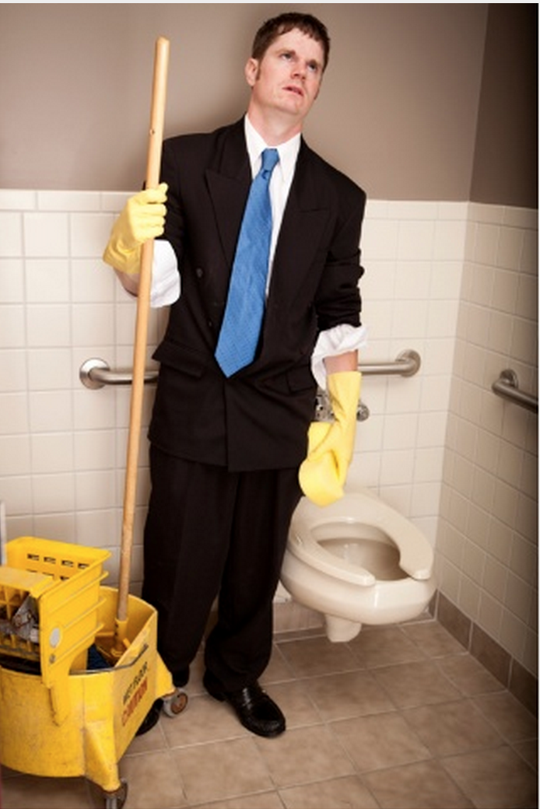
95% of time spent on data cleanup and feature engineering

Slide 8
Sensor Features
Sensor activation duration
Order of sensor activation
Relative order
Seconds from the start of activity
Seconds from the activity start normalized by the total activity duration in seconds
…

Slide 9


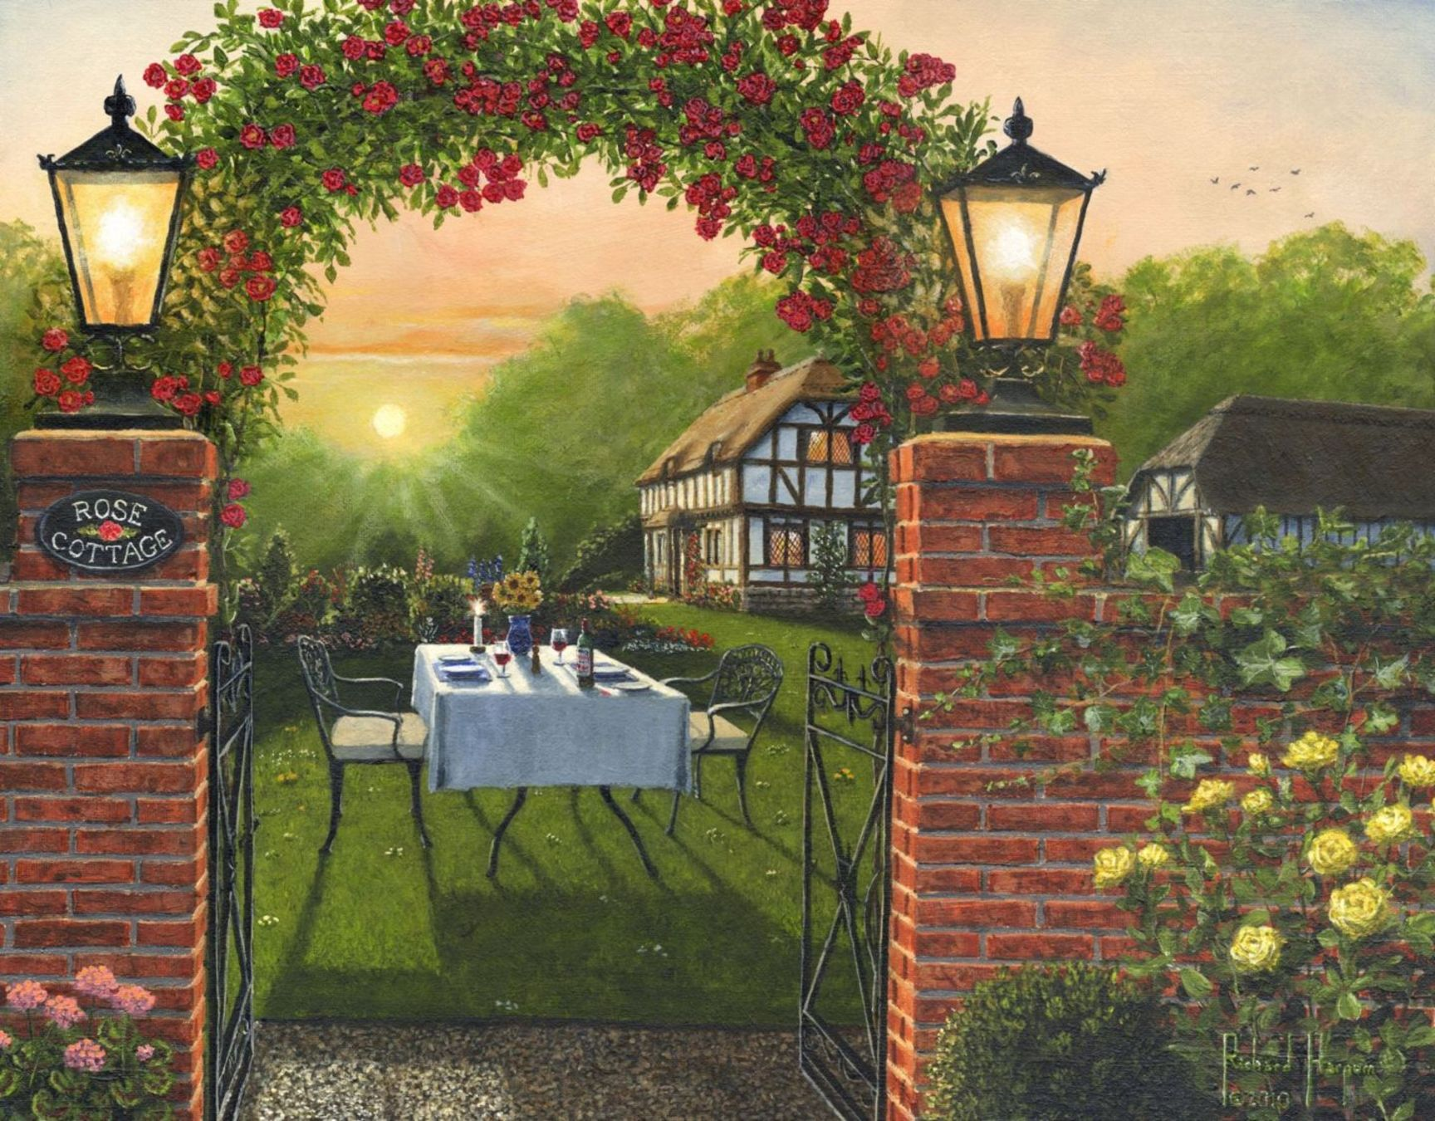

External features
Day of week
Time of day
4am-10am
10am-4pm
4pm – 10pm
10pm-4am
Potential feature candidates (not used here):
sensors locations, national holidays, …

Slide 10

Dataset
578 features
78 sensors
280 examples
13 activities
Lots of NaNs

Slide 11
Machine Learning
Decision tree (full/reduced features): 0.52 with full 0.55 with partial
Logistic Regression (full features): 0.5
KNN (full features): 0.53
Random forest (full features/partial features) 0.73 with full features, 0.57 with partial

Slide 12
WORKED
DID NOT WORK
Native Bayes
Reducing number of features for Random Forest
Logistic Regression
Taking time for feature engineering
Random Forest

Slide 13
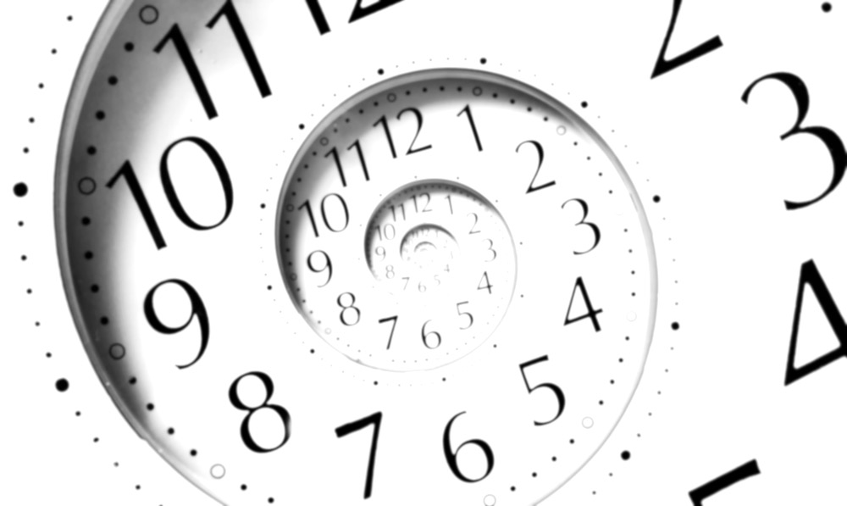
If I only had more time…
More features for Random Forest
Better feature engineering
More time on understanding results/refining the features

Slide 14
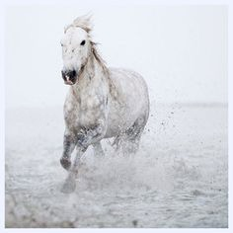
Conclusion
More Data and clever feature engineering beats better algorithms

Slide 15


